Slide 1
CONSTRUCTION OF A DTF
DO’s and DON’Ts

Slide 2
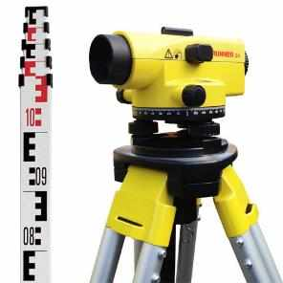
LEVELS
< 1%
< 1%
RBBT
< 10%
ST
< 1%
ABR
VFCW
Ensure sufficient gradient to enable the DTF to operate by gravity:
At least 1% slope between each module (10% between ABR and VFCW)
Design head of each module which is the level difference between the inlet and outlet
Minimum slope between modules: minimum of 0.5 m
Head difference of all modules: 3.15 m

Slide 3
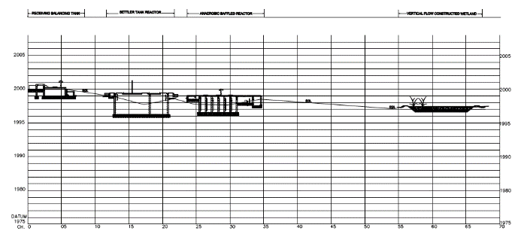
< 1%
< 1%
< 10%
Δ 0.8m
Δ 0.1m
Δ 1m
Δ 0.6m
Module inlet | Distances [m] | Minimum level difference [m]
Inlet RBBT and Inlet Settler
Inlet Settler and inlet ABR
Inlet ABR and Inlet VFCW
Inlet VFCW and Water body
5
1
20
450
0.8 + 0.05 = 0.85
1 + 0.1 = 1.1
1 + 0.2 = 1.2
4.5

Slide 4
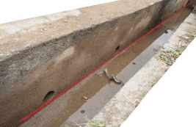
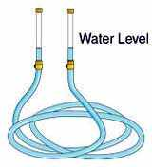
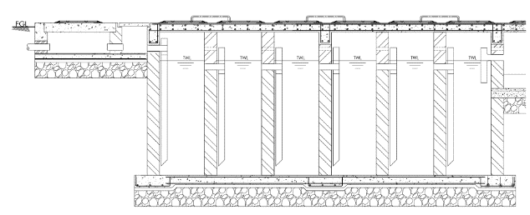
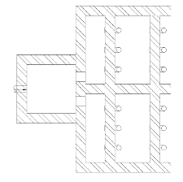
ABR PIPES
There are 4 different levels of pipes. It is extremely important that each pipes of the same level is placed accurately to ensure equal distribution and avoid shortcuts:
Use water tube to ensure straight level
1
2
3
4
2
3
1
ABR Cross-section
Inlet ABR Layout plan

Slide 5
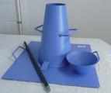
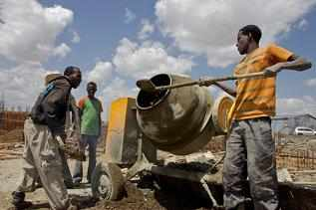
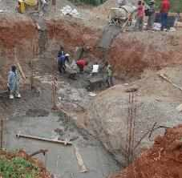
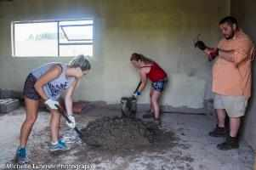
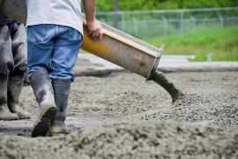
CONCRETE WORK
Concrete class 25
(1 : 1.5 : 3)
Correct ratio of cement/sand/aggregate (volumetric boxes)
Mix of concrete with clean water
Use of concrete mixer (no hand mixing)
Slump test (cone) to be done at each mixing of concrete to test the correct amount of water
Smooth transport to prevent adulteration, segregation and loss of ingredients
Pouring to be done as close as possible to final position

Slide 6
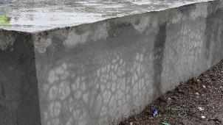
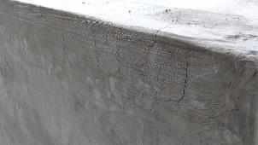
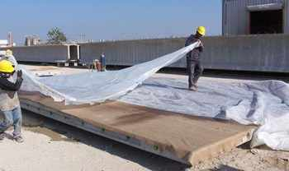
CURING
Curing process starts 4h after concrete placing
Keep moistened for a minimum of 7 days and protect from heat with a piece of fabric during the first 4h to keep the plastering moist and avoid cracks

Slide 7
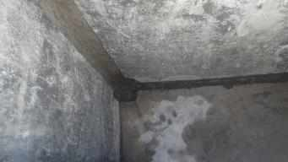
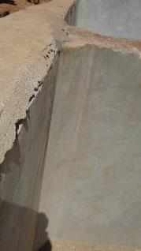
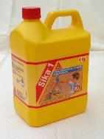
PLASTERING
Plaster walls internally and externally
Ensure that a proper water proofing is added to the plastering mix. Clean and remove all roughness and loose material of the exposed surface (brushing) before plastering
Wet down prepared areas immediately prior to use
Mortar joints should be bonded and sound. Any defective mortar joint should be raked out to a depth of 12.0mm and repointed using water proofing additive
Ensure that finishing mortar and plastering are mixed with clean water in a clean drum using paddle mixer
0.75Ltrs of water proofing additive per 25kg bag of cement

Slide 8
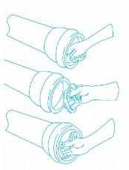
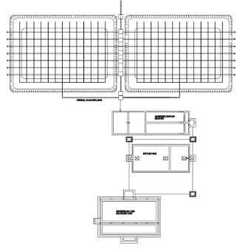
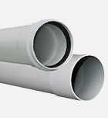
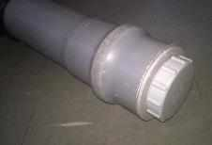
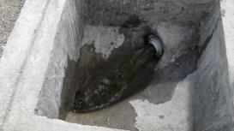
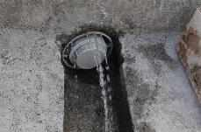
PLUGS AND SOCKET END PIPES
A minimum of 5 PVC plugs:
RBBT outlet and bypass
ST outlet and bypass
VFCW bypass
Ensure that the socket end of the pipes are placed where the PVC plugs are supposed to be located
Ensure water tightness of the plug joints by adding a rubber ring between the pipe and the plug

Slide 9
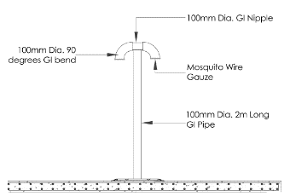
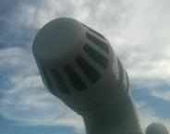
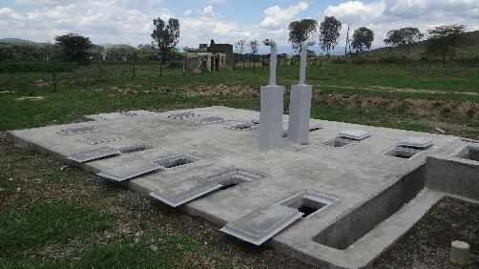
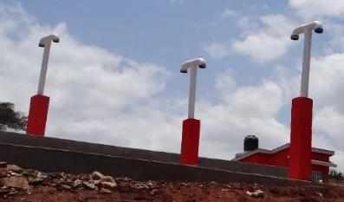
EXHAUST PIPES
1 for the settler and 2 for the ABR
100mm uPVC (class E) vent pipe with 3 coats of quality gloss paint
PVC wire gauze + vent caps
Protective concrete stub (min. 1m)
Provide aeration holes in between chambers to allow the gas to reach the exhaust pipes

Slide 10
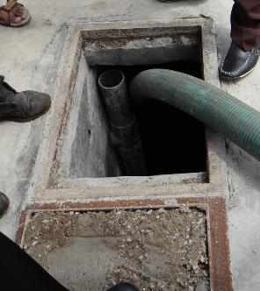
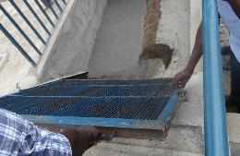
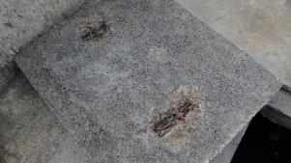
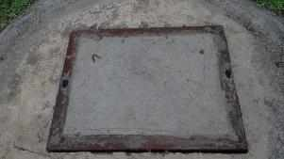
METAL AND SURFACE REINFORCEMENT
All reinforcement (mesh and bars) must be covered with concrete to avoid contact with water, oxygen and other strong oxidants or acids and therefore avoid rust
All metal surfaces (screens) must be painted with 1 coat of primer and 2 coats of quality gloss paint

Slide 11
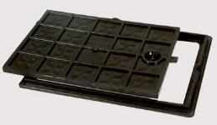
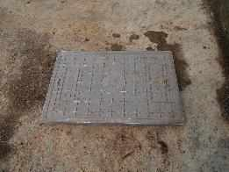
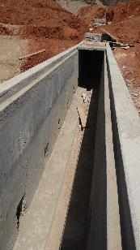
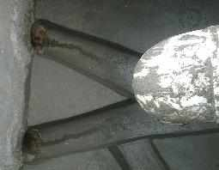
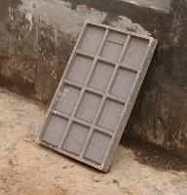
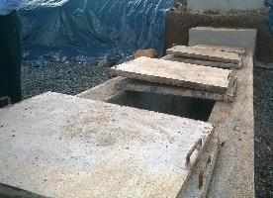
MANHOLES AND COVERS
Inspection chamber placed every 25m of buried pipe and any bend of the pipe
Ensure proper manhole benching to lead the flow
Encourage the implementation of reinforced fibreglass manhole cover (over polythen) as much as possible
For PCC (in the VFCW) ensure :
proper dimensioning (to avoid heavy lifting)
recess on the supporting edges
Metal framework
Two lifting handles

Slide 12
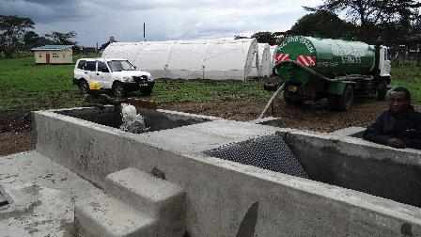
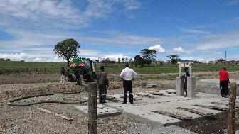
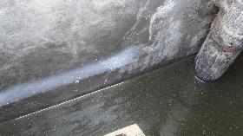
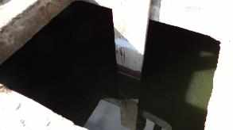
WATER TIGHTNESS TEST
Each tank should be filled with water (drinking water or from a water body) for at least 48H
The reference water level should be measured after half a day to take into account the soaking effect of the wall
The chambers of the ABR should be filled all together progressively to avoid putting pressure on the walls

Slide 13
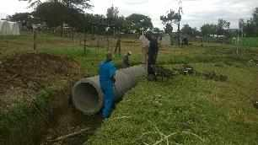
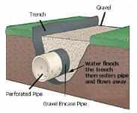
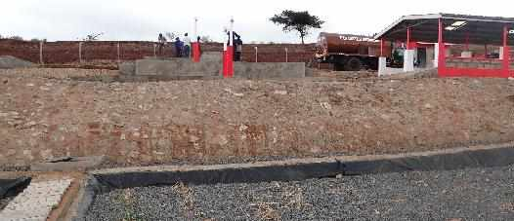
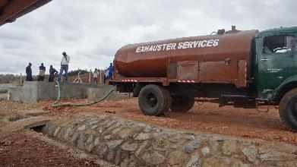
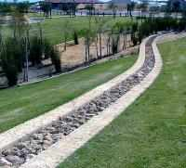
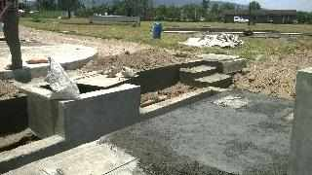
STORM RUNOFF DRAINAGE
Ensure proper drainage to avoid flooding and erosion issues:
Open trenches
Buried perforated pipes
Stone pitched or grass planted slope
Partitioning walls

Slide 14
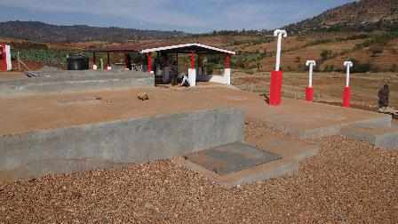
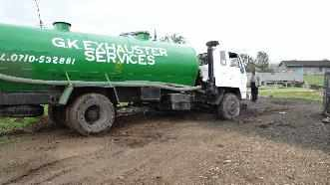
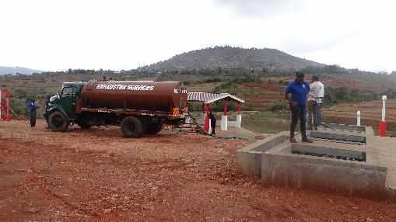
ACCESS ROAD
Access road must be stable enough to prevent exhauster to get stuck by rainy day:
Access road to the DTF: Compacted marram road laid on a hardcore compacted base
Access road within the DTF: 6-10mm gravel road laid on a hardcore compacted base

